Slide 1
WiFi
By: Christian pervan

Slide 2
What is WiFi?
Short for Wireless Fidelity
Label for products that can be used within a WLAN network
The brand name for the IEEE 802.11 standard
Colloquially used to refer to the WLAN network itself

Slide 3
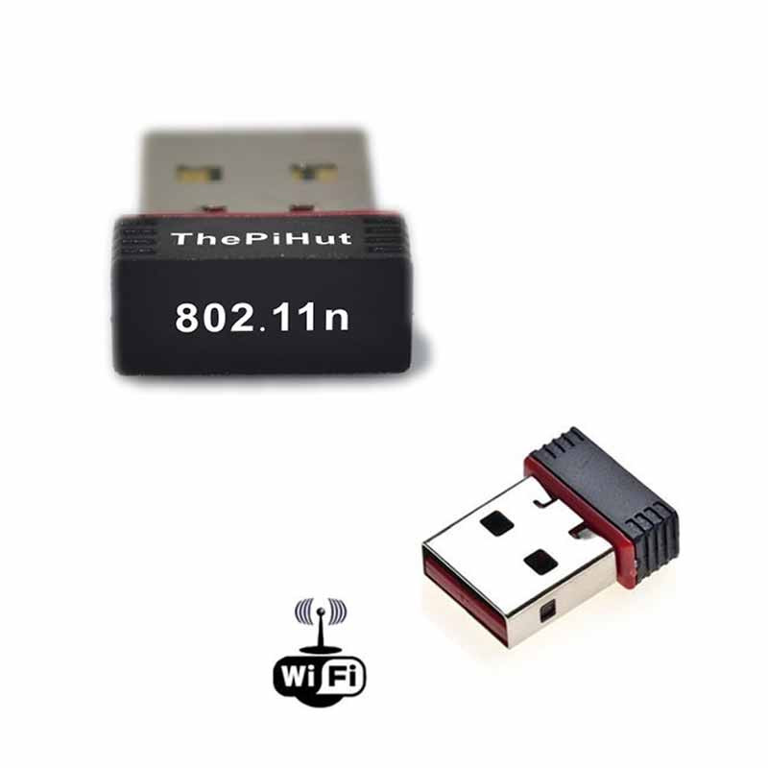
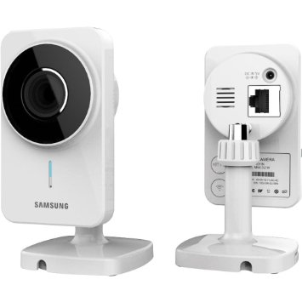
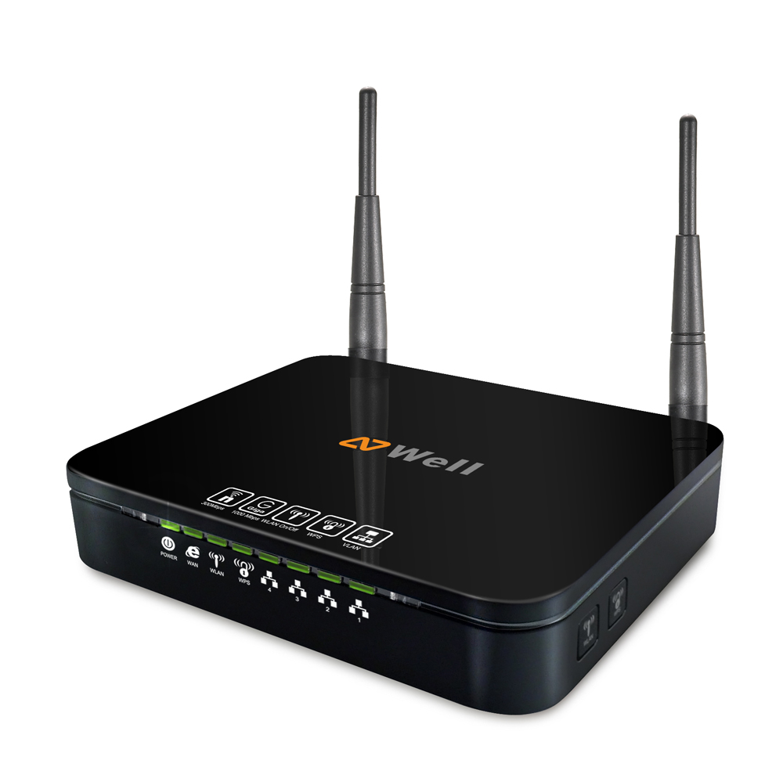

Slide 4
What is WLAN?
Wireless Local Area Network
Connects multiple devices together using a wireless distribution method
Connection range is limited
Most commonly used in homes, workplaces at first
Now, it is used everywhere, in virtually every semi-popular public area
Operates under the IEEE 802.11 standard

Slide 5
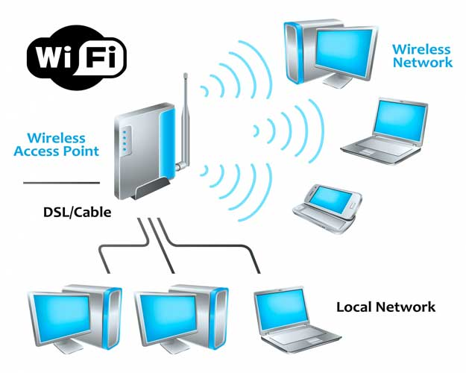

Slide 6
IEEE 802.11
Set of MAC and physical layer specifications
Used in the implementation of WLAN networks
Maintained by Institute of Electrical and Electronics Engineers (IEEE)
802 is the specific IEEE committee in charge of upholding these standards
Founded by NCR Tech and AT&T in 1991, originally devised in 1990 by Victor Hayes
Under Hayes’ leadership, the standard evolved into what it is today
In 1999, was trademarked as WiFi

Slide 7
How does WiFi work?
Radio frequencies – broken up into channels, within a specific range of bandwidths
Frequency bandwidths: 900 MHz, 2.4 GHz, 3.6 GHz, 4.9 GHz, 5 GHz, 5.9 GHz and 6.0 GHz
Each frequency bandwidth is split up into channels
Channel availability and usage regulated on a per country basis
Access points connected directly to network, broadcast the signal through waves
Compatible devices, pick up signals and connect to network
The Internet is just a LAN network where the network is an Internet modem
Notes:
2.4 and 5.0 commonly used, especially 2.4
3.6 – US exclusive, high powered stations
4.9 – US exclusive, used for public safety purposes
5.9 – Vehicles
6.0 – Gb+ speeds
7

Slide 8
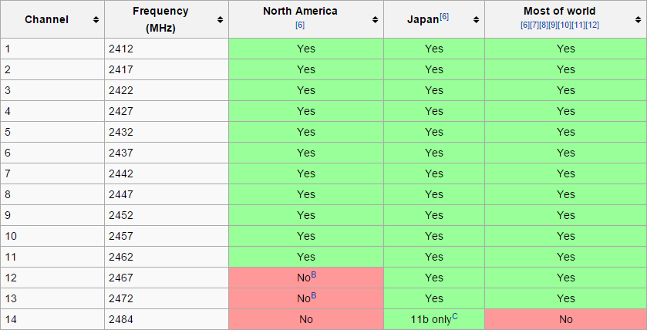
2.4 GHz
Notes:
Top chart is a visual represetation of wireless channels, related to the chart directly below it

Slide 9
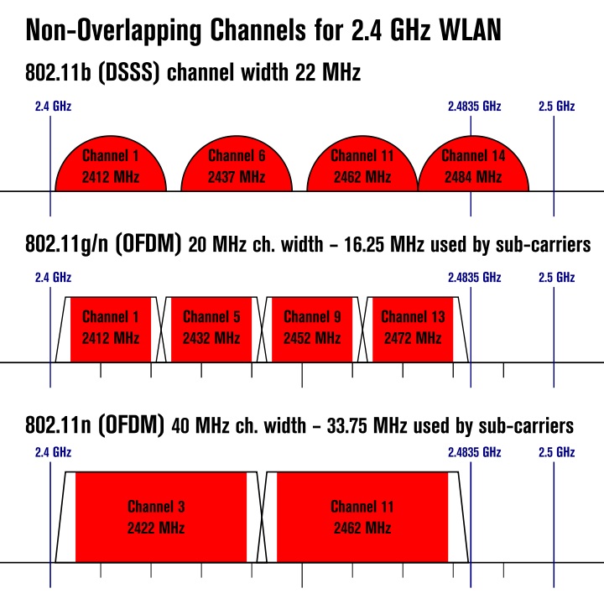
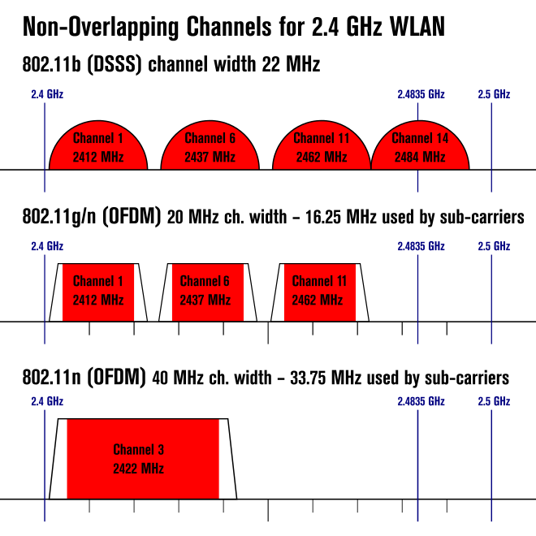
2.4 GHz – USA vs World
Notes:
DSSS – direct sequence spread-spectrum
OFDM - orthogonal frequency-division multiplexing
USA reserves channels for long distance usage on more powerful spectrums
9

Slide 10
Is WiFi secure?
No
Very easy access
Service Set ID (SSID) and password
SSID isn’t very hard to obtain
How easy is it to get a password, though?

Slide 11
Three types of password algorithms
WEP
WPA
WPA-2

Slide 12
Wired Equivalent Privacy (WEP)
Earliest form of WiFi security algorithm
Originally introduced with original specifications in 1997
Provides data confidentiality that a wired network would provide
Uses only hexadecimal digits

Slide 13
Wired Equivalent Privacy (WEP) - Encryption
Encrypts using the RC4 cipher
4 different standards: 64-bit, 128-bit, 152-bit, and 256-bit
64-bit: a 10 hex digit key (totals 40 bits) plus a 24-bit starting variable
128-bit: a 26 hex digit key (totals 104 bits) plus a 24-bit starting variable
152-bit: a 32 hex digit key (totals 128 bits) plus a 24-bit starting variable
256-bit: a 58 hex digit key (totals 232 bits) plus a 24-bit starting variable
Is there a problem?

Slide 14
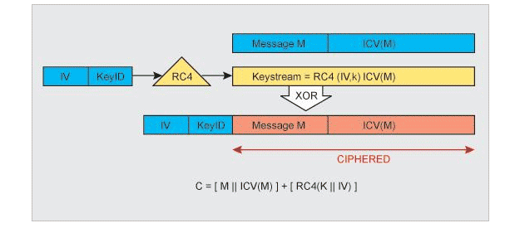
Notes:
Initialization vector (IV) and the user’s key ID are hashed by a XORed combination of the stream and the message and IV of the message above it. The original IV and user key are appended to the end of the ciphered message to form the RC4 key.

Slide 15
Problem with WEP
RC4 is a STREAM cipher
Starting Variables must be unique for security
Problem – too easy to have duplicates
Packets sent by router are encrypted by the same WEP key
24-bit SV’s = 2^24 = 16 777 216 distinct possibilities
For 24-bit SV’s, chances duplicates happen about every 5000 packets is ~52%!
We can rapidly go through this amount of packets and can end up reverse engineering a WEP key once found a correct SV, and correct RC4 key
Also known as the related key attack

Slide 16
Wireshark
Used to sniff packets
Very widely available program – absolutely free
Compatible with most common operating systems
Drawback – you cannot specify channels
Lots of unnecessary clutter
Cracking algorithm will have to sift through more possibilities
Excruciatingly time consuming unless lucky, especially as we go on

Slide 17
CommView
Sniffs packets
You can specify channels and frequencies
A lot more intuitively geared for WiFi scanning and built for such
A lot less time consuming on both scans and cracking
Drawback: Little compatibility, Very expensive
Only compatible with Windows
Costs $499.00!!!
30 day trial, so for temporary quick use, expensive isn’t a factor
Can convert logged packets into Wireshark format for compatibility with Aircrack

Slide 18
Aircrack
Performs the cracking itself
Free
Compatible with most systems
Windows comes with GUI solution
Uses Wireshark packet dumps to sniff around and crack
Dictionary can be used as well to expedite process

Slide 19
Aircrack mini-demo

Slide 20
How do we improve on this?
Larger keys
Ability to include ASCII symbols and letters other than hex
Dynamically encrypt outgoing packets

Slide 21
Wi-Fi Protected Access (WPA)
Response to issues with WEP
Became available in 2003
All keys are 256-bit
Introduces the Temporal Key Integrity Protocol (TKIP)
TKIP employs a different key each packet, meaning the method of sniffing around is out
Introduces a stronger checksum algorithm called Michael

Slide 22
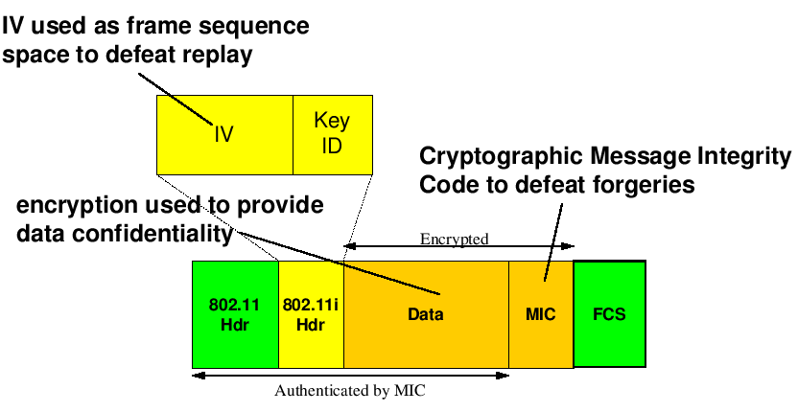

Slide 23
Are there still vulnerabilities?
Yes, there are
Michael can be fooled by re-injecting and spoofing shorter packets
2^256 is still finite, so there are still finite password possibilities
Passwords still not very strongly encrypted – RC4 is still used
Brute force attacks, while they take longer due to more randomness, still work
Routers that have their own WiFi Protected Setup (WPS) button are still vulnerable despite more secure key due to vulnerabilities present in WPS.
Much more advanced tools can hack it more easily

Slide 24
Can we improve on this further?
Yes
Greater password encryption standards

Slide 25
Wi-Fi Protected Access II (WPA2)
Even further response to WEP and WPA
Introduced in 2004
Contains much of the same policies that WPA had
Only one major difference
All passwords are now encrypted by Counter Mode Cipher Block Chaining Message Authentication Code Protocol (CCMP)
CCMP is a derivative of AES
AES is extremely powerful encryption, extremely hard to hack in any sort of timely matter
Virtually impenetrable other than through WPS or really highly advanced tech

Slide 26
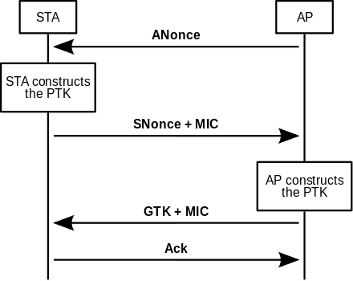
Notes:
Access point delivers one time use number to station
Station constructs pairwise transparent key
Station sends its own 1 time use number + Michael authenticator to AP for AP’s on PTK construction
AP sends group temporal key + Michael authenticator to station
Station acknowledges Access Point
26

Slide 27
What are some other things that WiFi is exposed to?
Human element
Spoofing
Accidental access
Breach of confidential information
Denial of Service
Domino effect – hack one lesser secure router to bring down a whole system

Slide 28
Deauthentication Attack
Type of man in the middle attack
Eavesdrop on flow between access point and other computer
Relies on faults in handshake protocol
Hacker can force computers connected to an access point to lose connection and reconnect with hacker’s access point
Used in both evil twin and denial of service attacks
Evin twin – hacker’s AP, denial of service – disconnect user from AP
One example of a multitude of potential MitM attacks based off same strategy

Slide 29
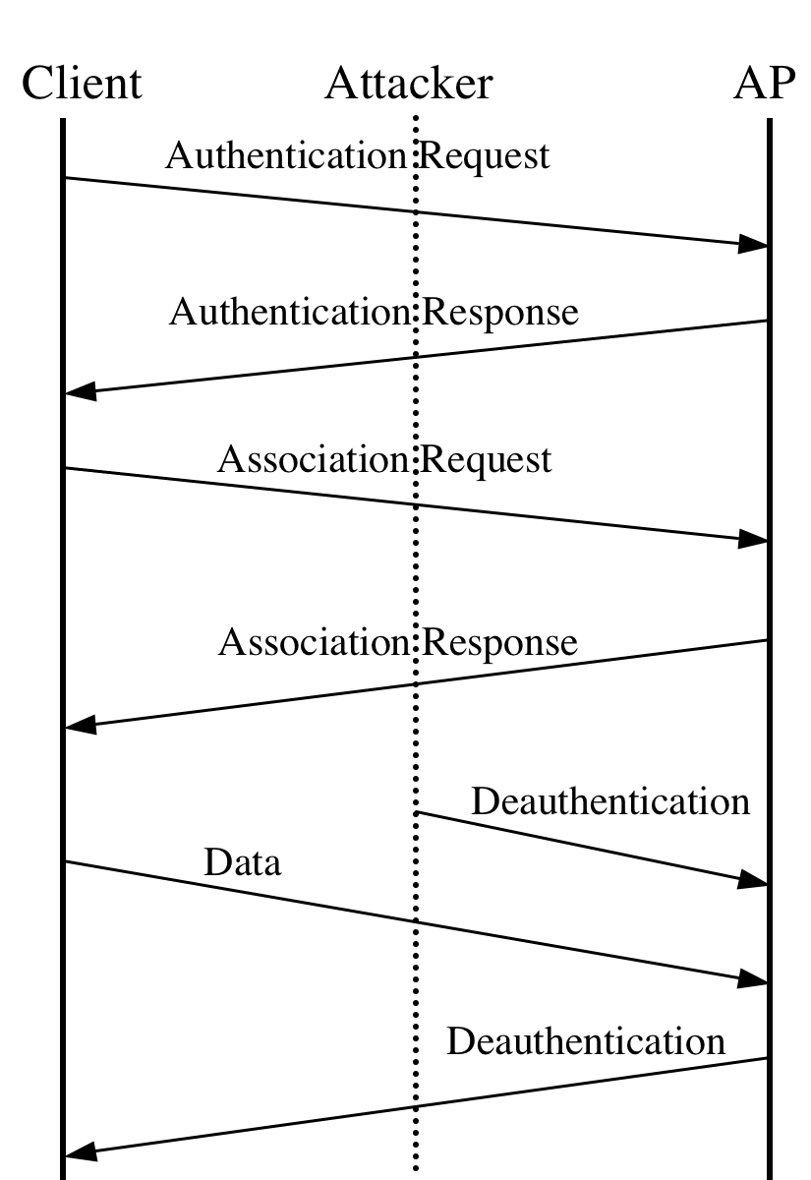

Slide 30
Evil Twin
Fake access point created to deceive someone into connecting
User thinks he is accessing a WiFi spot completely legitimate, but it is really bogus
Enticing words such as “free” or “fast” used as lure in SSID
Typosquatting in SSID used as well
Victims can have their every move logged
Record victim’s patterns and use of Internet, sites visited
Monitor communications involving victim
Steal victim’s sensitive info
Commonly set up in public places

Slide 31
Evil Twin – Demo
http://null-byte.wonderhowto.com/how-to/hack-wi-fi-creating-evil-twin-wireless-access-point-eavesdrop-data-0147919/

Slide 32
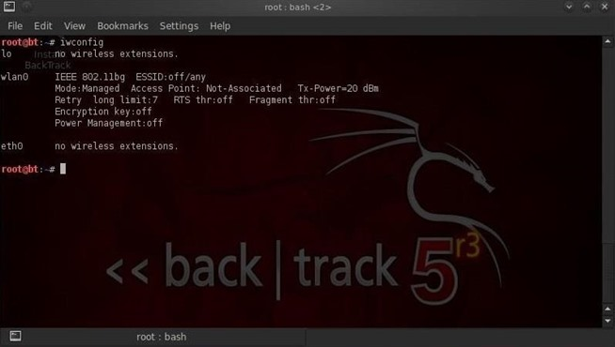

Slide 33
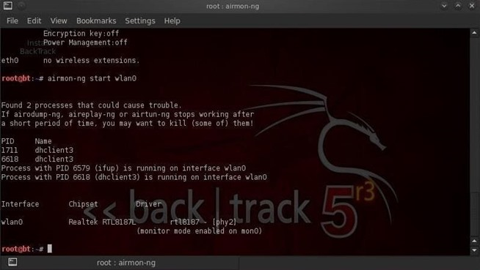

Slide 34
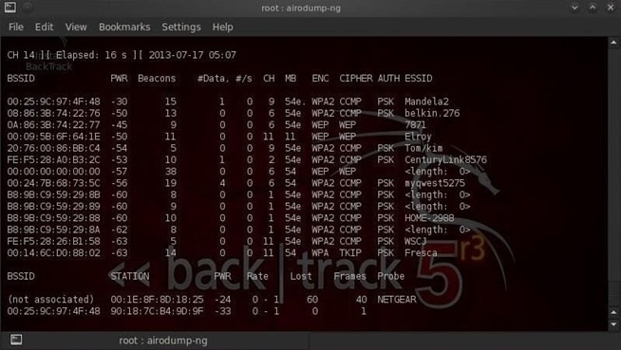

Slide 35
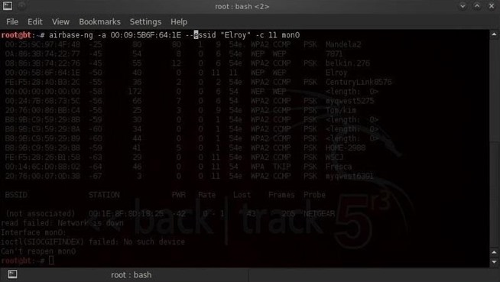

Slide 36
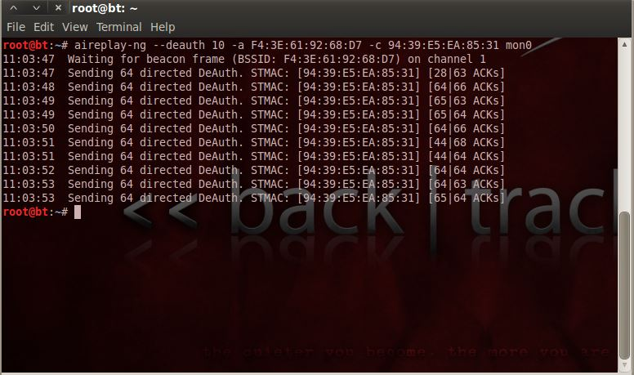

Slide 37
Denial of Service (DoS)
Boot a user off a connection to access point
Shut down an access point and prevent access to it
Latter is moreso under this category
Popular form – DDoS (Distributed Denial of Service)
Pings are used by hacker to get mandatory response from access point access point
In DoS attack, hacker absolutely bombards access point with more pings than it can handle
Access point shuts down as it can’t handle requests
Can take a while to get back up

Slide 38
Denial of Service – Demo
http://null-byte.wonderhowto.com/how-to/hack-wi-fi-performing-denial-service-dos-attack-wireless-access-point-0147988/

Slide 39
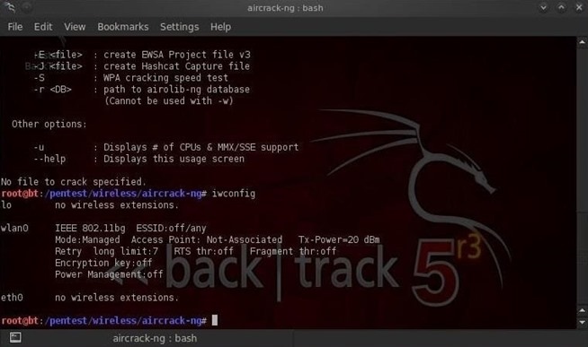

Slide 40
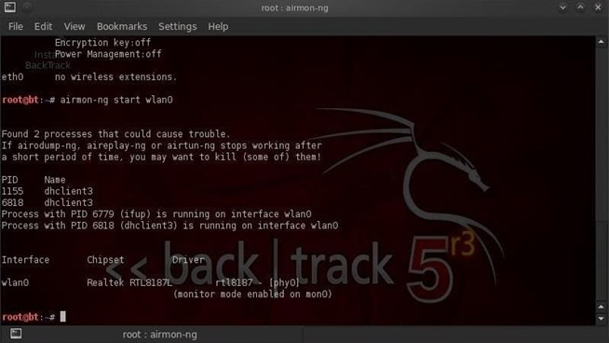

Slide 41
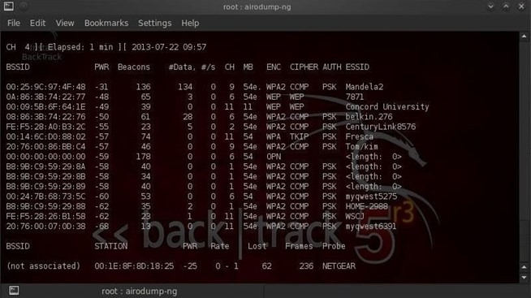

Slide 42
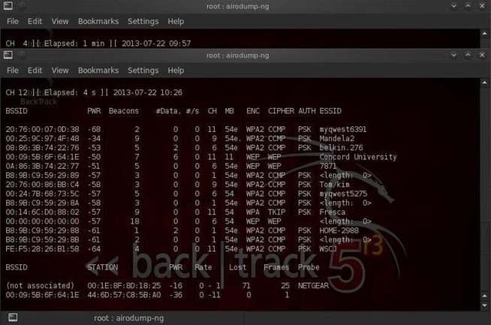

Slide 43
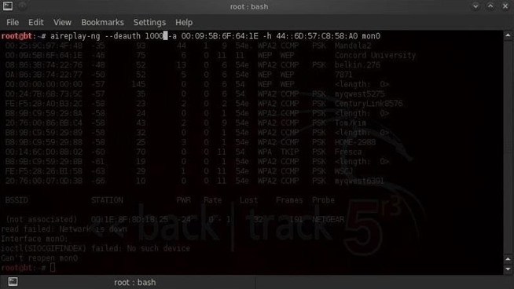

Slide 44
Famous DoS attacks
Anonymous vs Scientology: http://www.washingtonpost.com/wp-dyn/content/article/2008/01/25/AR2008012503399.html
Cyberbunker vs Spamhaus (and everybody): http://www.popsci.com/technology/article/2013-03/biggest-cyber-attack-history-just-happened-and-i-feel-fine
Lizard Squad vs PlayStation Network and Xbox Live: http://www.theguardian.com/technology/2014/dec/26/xbox-live-and-psn-attack-christmas-ruined-for-millions-of-gamers

Slide 45
Preventing DoS
Black holing – dropping all IP packets from an attacker
Attacker can change source address, even be dynamic – not very effective consistently
Attacker can spoof legitimate partner, resulting in legitimate packets being dropped and hacker being accepted
Validate handshake – send acknowledgment from server to client after receipt of a SYN packet, but don’t accept any of the SYN sent back
Not accepting sent back SYN’s – handling higher volumes becomes less of a burden
Rate limiting – deny too many requests from one source at a time
Downside is in that it also applies to legitimate users

Slide 46
Preventative Measures
We already know restricting access, but what about other measures?
Can we make our SSID less visible to others?
Can we whitelist and blacklist certain devices?
Can we require clients to set up their own IP’s?
How do we protect our network without having to bolster the WiFi access point

Slide 47
Preventative Measures
We already know restricting access, but what about other measures?
Can we make our SSID less visible to others?
Can we whitelist and blacklist certain devices?
Can we require clients to set up their own IP’s?
How do we protect our network without having to bolster the WiFi access point

Slide 48
SSID/Network Cloaking
Hides our SSID from being easily accessed
Most scanners will not be able to detect SSID by itself
Forces a user to manually enter SSID when trying to connect to access point
Mainly used to impede casual snoopers
Drawback – this is nothing for even decently advanced hackers
Security through obscurity
SSID can still be easily retrieved by hackers emulating a probed network
Vulnerability in forcing network to search for everywhere of SSID

Slide 49
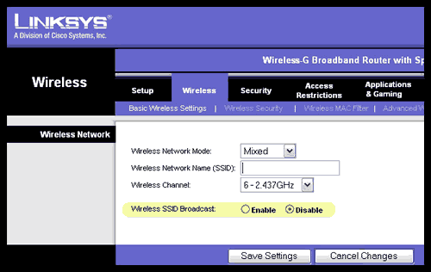
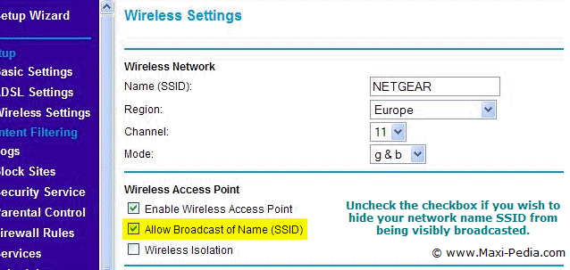
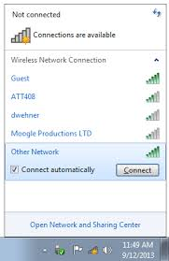
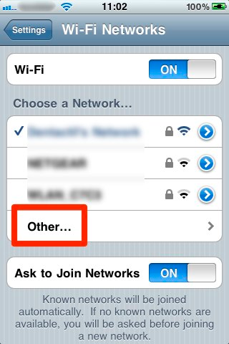
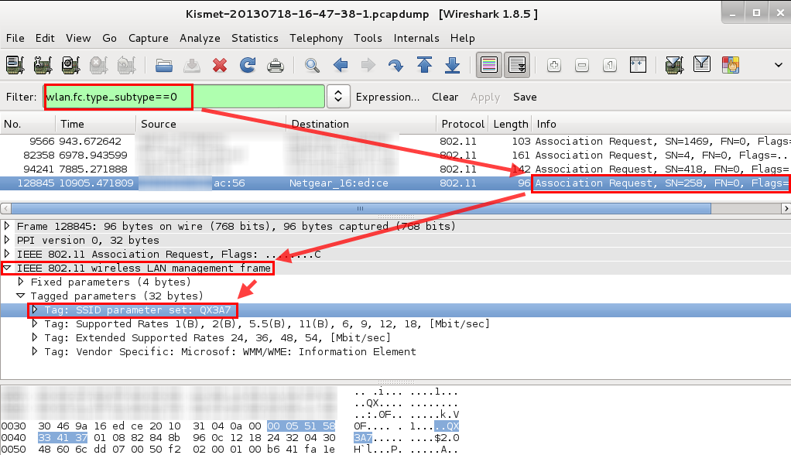

Slide 51
MAC Filtering
Whitelisting OR blacklisting mechanism
Only grants access to pre-approved MAC addresses
Can also do the same for approving access to everyone but those of specific MAC addresses
MAC address – Media Access Control address
48-bit physical identifier of a networking device
Also easy to hack
MAC Spoofing – it is easy to just simulate another device’s MAC address
Sniff network for packets to find the appropriate MAC address to spoof

Slide 52
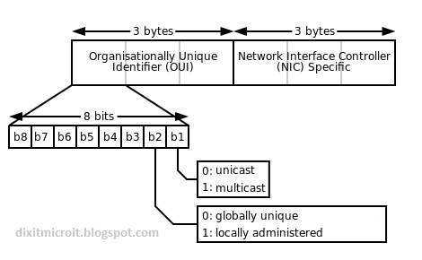

Slide 53
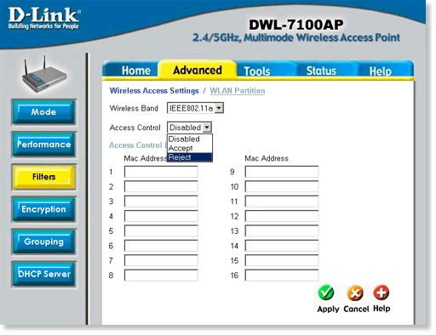
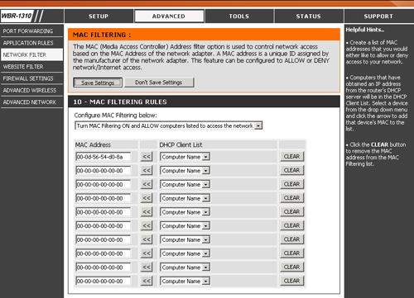

Slide 54
RF Shielding
Radio Frequency Shielding
Physical defense
Uses special kinds of wall painting/film and/or signal jammers
Reduces range that WiFi can be accessed in
Keeps WiFi within premises
Generally, best used within trusted workplaces
Drawback – moles
Can be hacked from the inside if additional steps are not taken
From inside, hackers can access using connected computers as a gateway
Can also be expensive

Slide 55
Best ways to defend against attacks?
Strong password
Always use WPA2 with AES
Hide your SSID
Filter MAC addresses
Whitelist for best security
If affordable: Use Wireless Intrusion Detection System
Using sensors to filter out rogue access points and rogue packets
Fingerprinting and footprinting
If possible, try to use wired whenever you can
Shut down network when it is not being used

